Slide 1



Projeto 2
View in Power BI
Last data refresh:
04/03/2024 19:15:46 UTC
Downloaded at:
04/03/2024 19:19:30 UTC

Slide 2
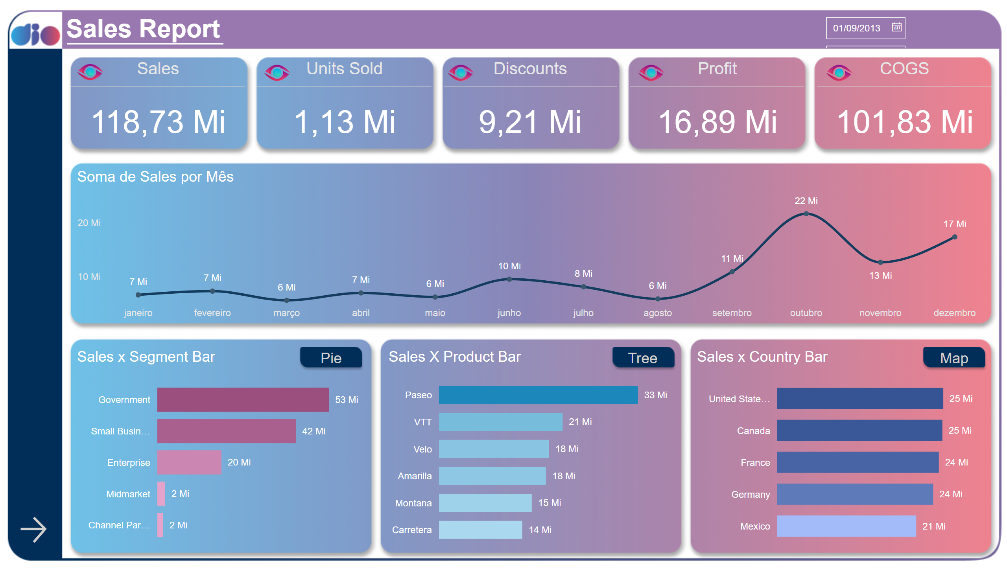
Sales
Notes:
Botão page 2
No alt text provided
Titulo página
No alt text provided
shape
No alt text provided
slicer
No alt text provided
Sales x Segment Bar
No alt text provided
image
No alt text provided
actionButton
No alt text provided
Botão Segment Pie
No alt text provided
pieChart
No alt text provided
actionButton
No alt text provided
Botão Prod Tree
No alt text provided
Sales X Product Bar
No alt text provided
treemap
No alt text provided
image
No alt text provided
image
No alt text provided
Botão country Map
No alt text provided
map
No alt text provided
actionButton
No alt text provided
Sales x Country Bar
No alt text provided
image
No alt text provided
Sales
No alt text provided
actionButton
No alt text provided
image
No alt text provided
actionButton
No alt text provided
Units Sold
No alt text provided
lineChart
No alt text provided
lineChart
No alt text provided
lineChart
No alt text provided
lineChart
No alt text provided
lineChart
No alt text provided
image
No alt text provided
actionButton
No alt text provided
Discounts
No alt text provided
actionButton
No alt text provided
COGS
No alt text provided
image
No alt text provided
Profit
No alt text provided
image
No alt text provided
actionButton
No alt text provided

Slide 3
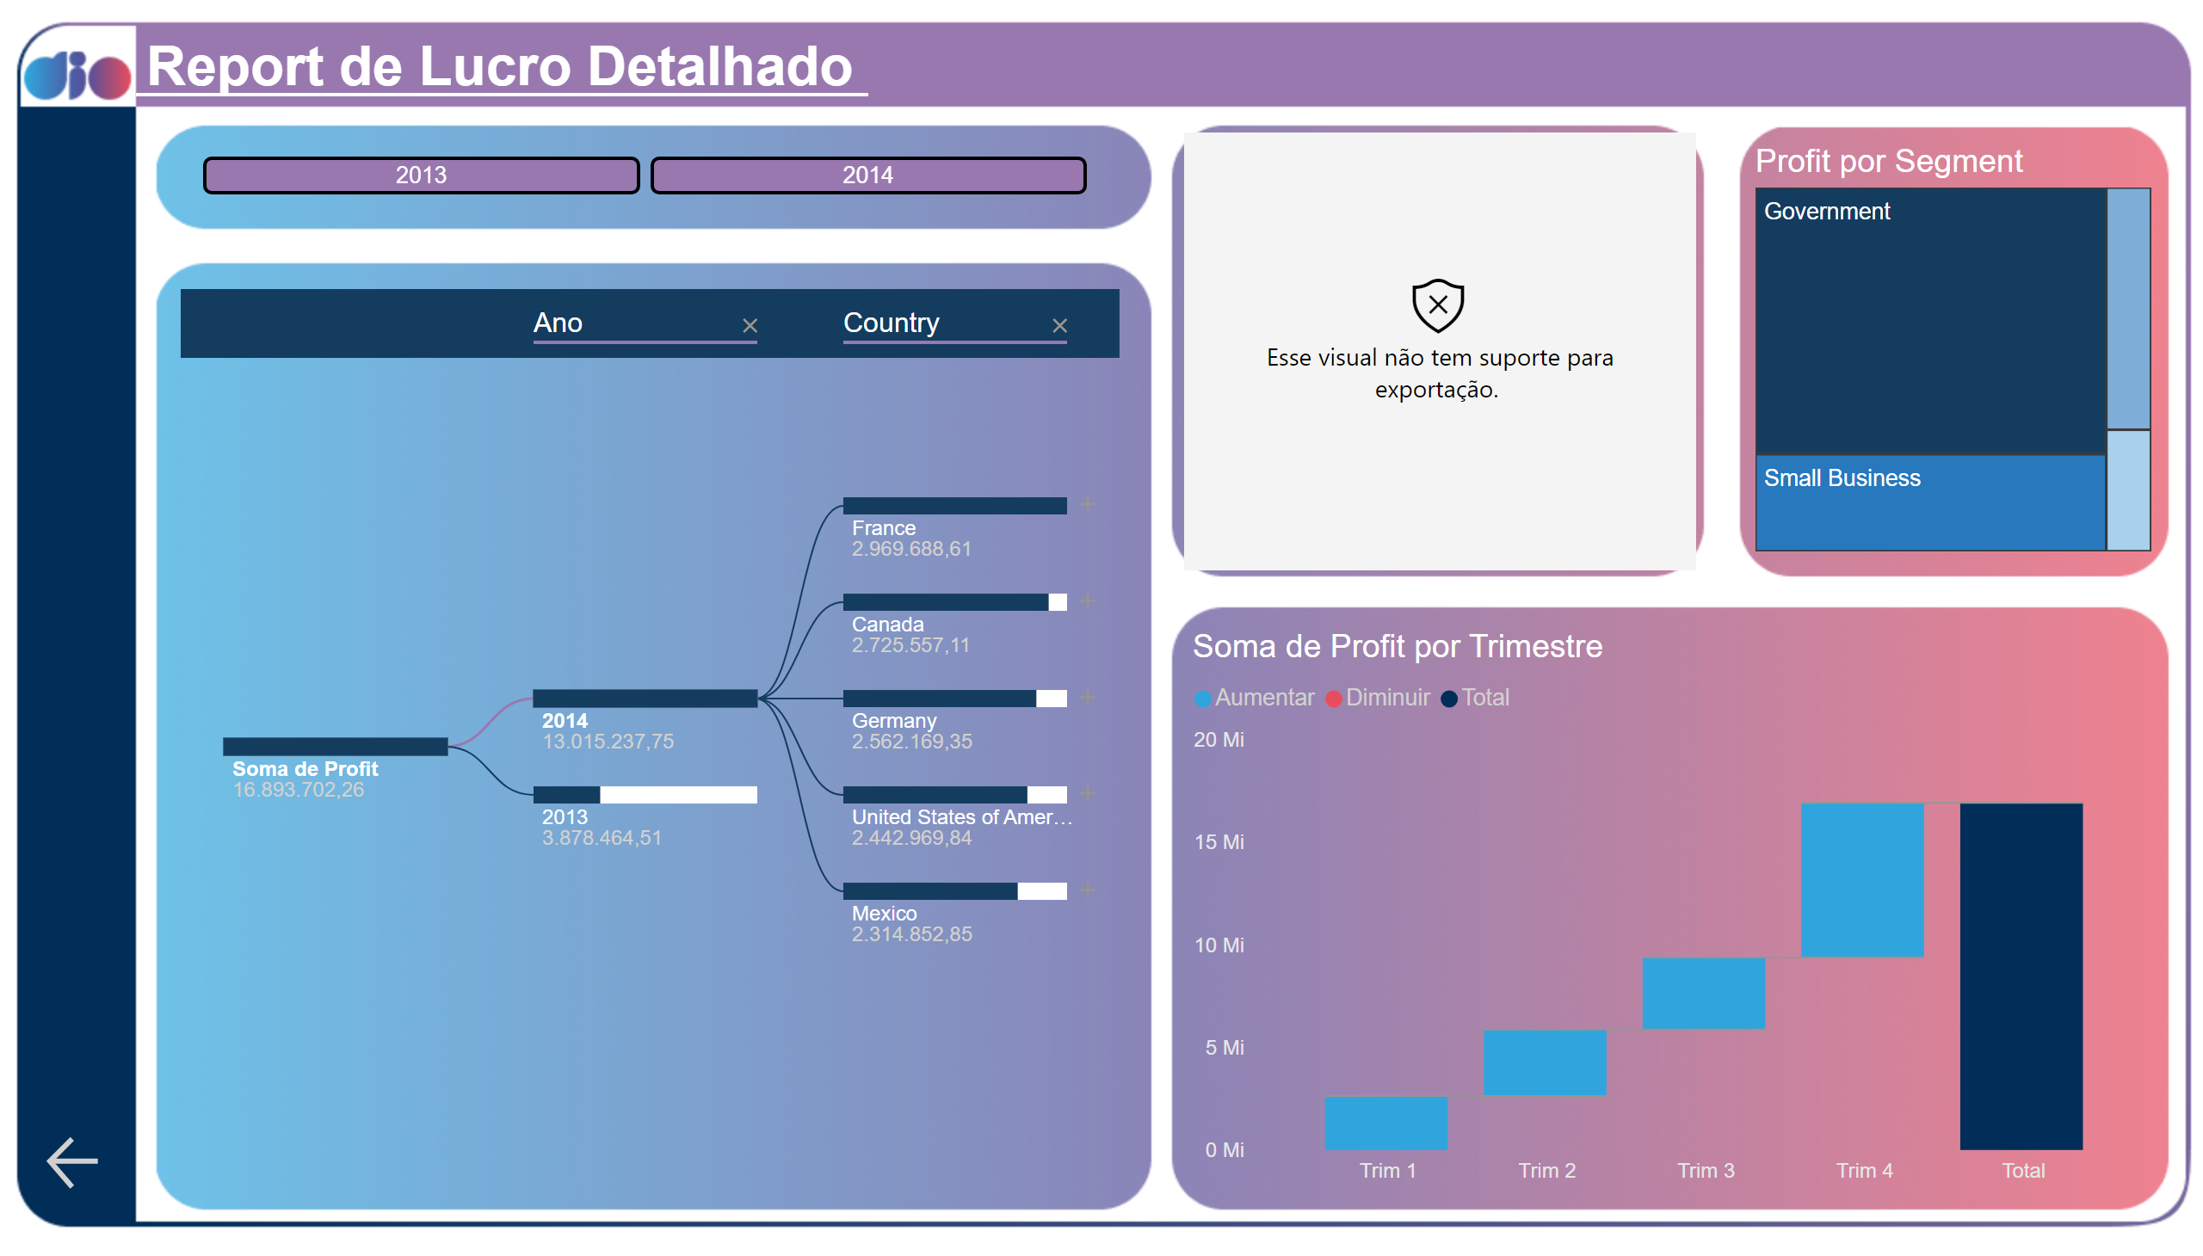
Lucro
Notes:
Pagina 1
No alt text provided
shape
No alt text provided
textbox
No alt text provided
ChicletSlicer1448559807354
No alt text provided
decompositionTreeVisual
No alt text provided
radarChart
No alt text provided
Profit por Segment
No alt text provided
waterfallChart
No alt text provided

